Slide 1
Investigation of Atmospheric Arctic Wildfire Tracers at Summit, Greenland
Jashan Chopra

Slide 2
Approach
Removing machinery & camp interference with meteorological analysis
Creating ethane/methane and acetylene/methane ratios
Harmonic fitting with NOAA curve fitting tool
Creating z-scores to identify potential pollution plumes
Creating back trajectories from ratio data points
Matching with NASA VIIRS fire data
Develop final globe plot
Report statistics to ascertain usefulness

Slide 3
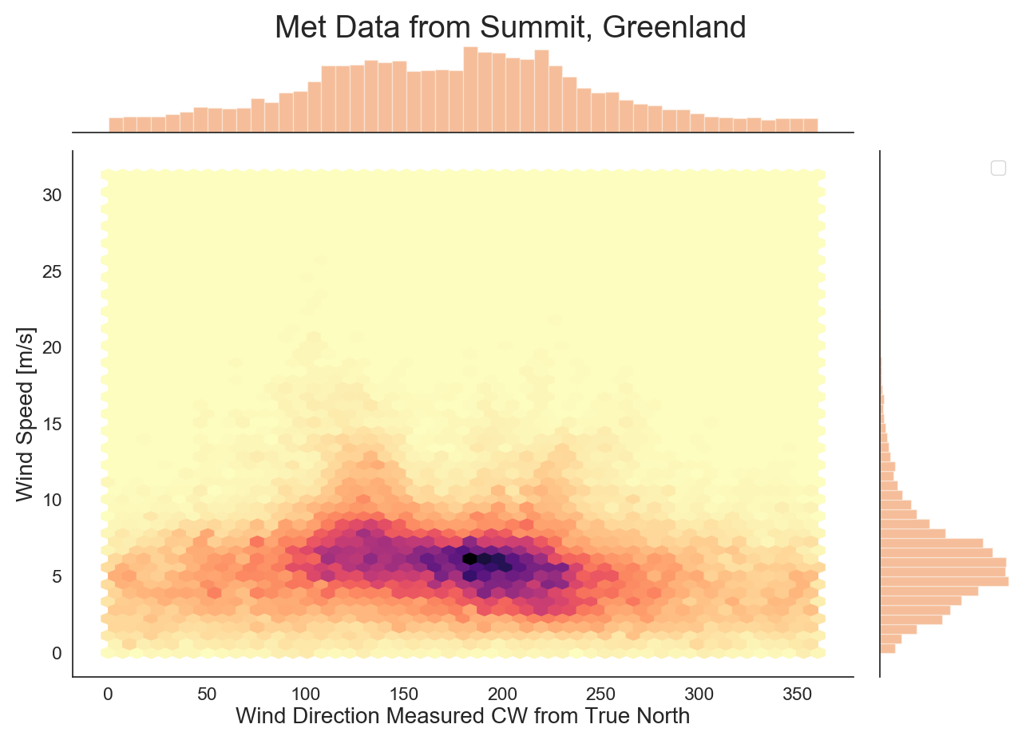
Analyzing
Met Data
From Summit

Slide 4
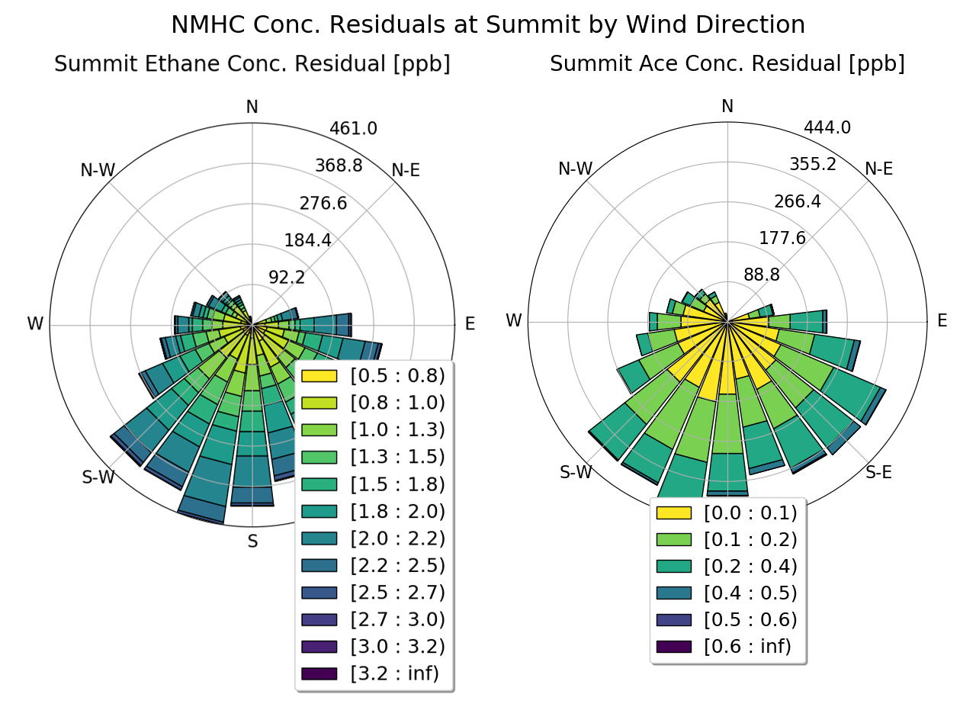
Removing Machinery Pollution at TAWO
As per the Summit clean air management plan, air at the TAWO building is considered to be impacted by local sources when the wind direction is between 342 and 72 degrees (i.e., from the NNE) or when the wind speed is less than 1.03 meters per
second.

Slide 5
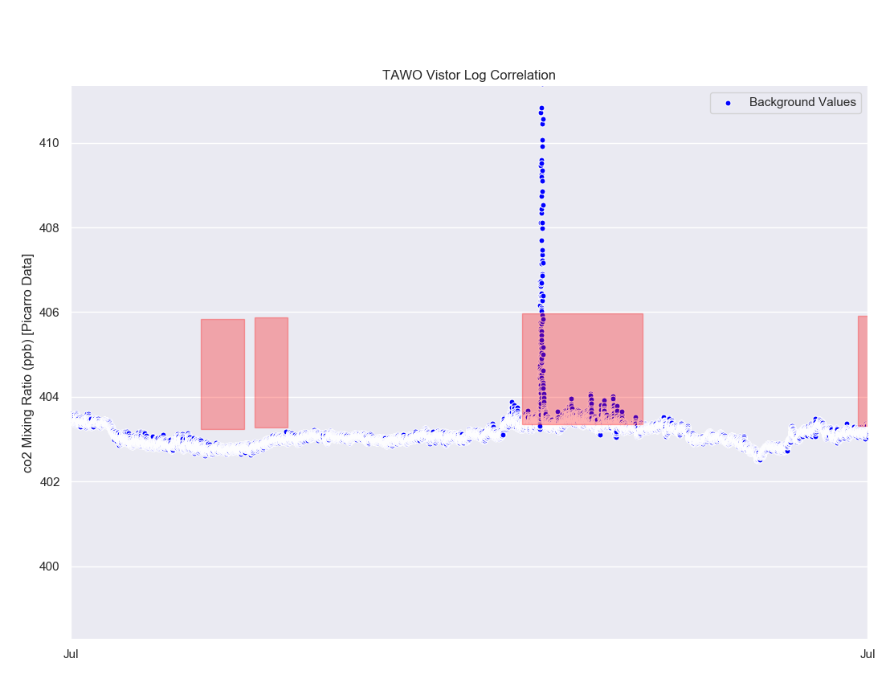
CO2 & TAWO Visitor Log
Record of entering & exiting TAWO building.
Removal of highlighted regions if three standard deviations out compared to previous weeks data.
To be implemented in future processor, does not affect this investigation as Picarro products were not used.

Slide 6
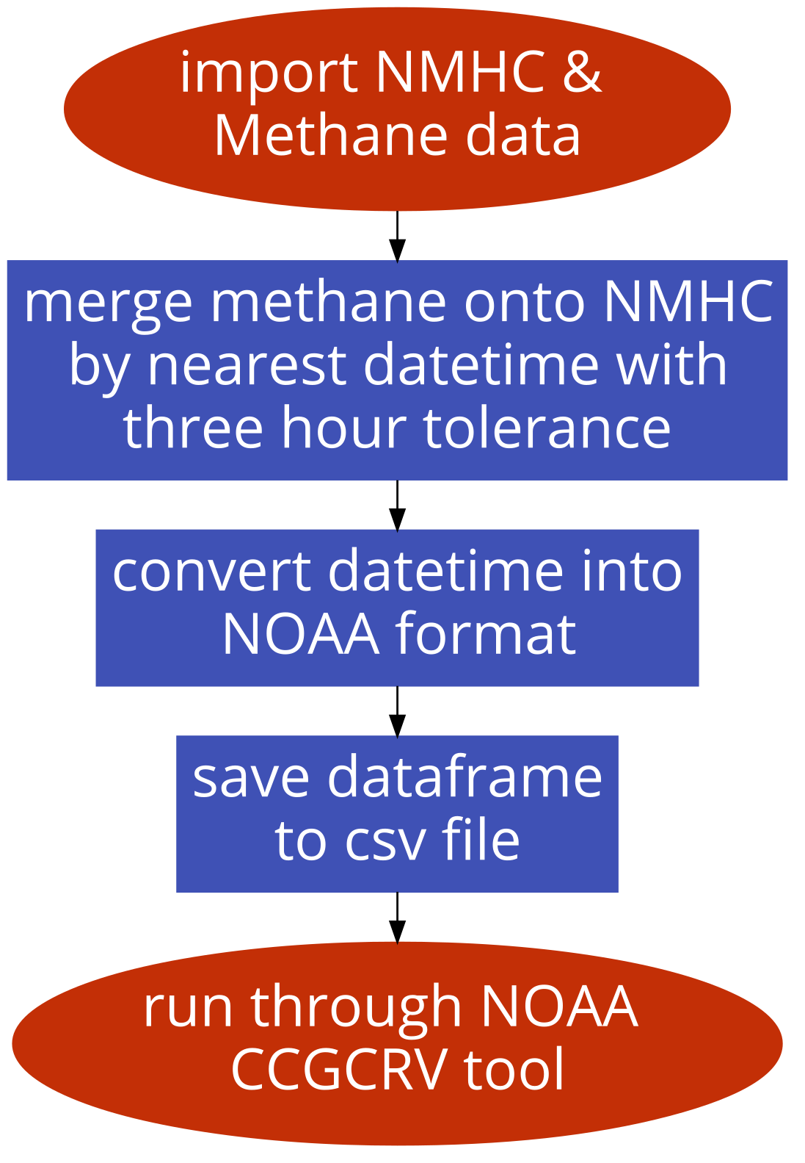
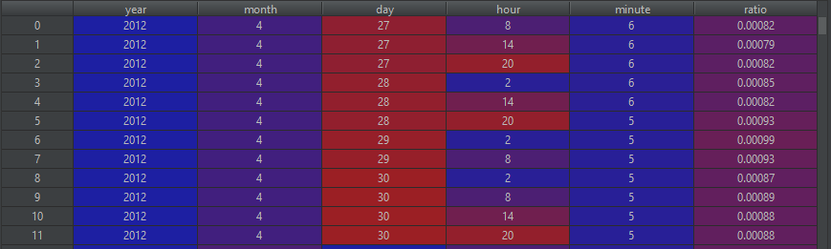
Ratio Creation Flowchart*
*Original code and detailed flowcharts in report

Slide 7
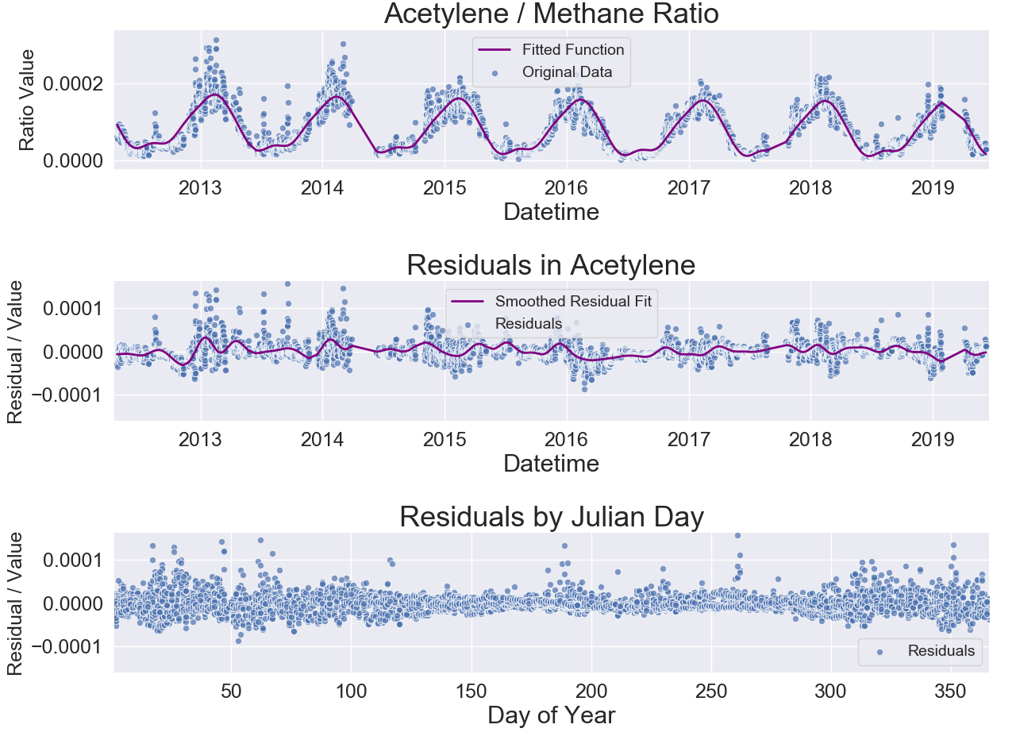
Harmonic Fitting
Residual
Residuals seem higher in the winter because of seasonal cycle.
Should they be normalized?
Residual

Slide 8
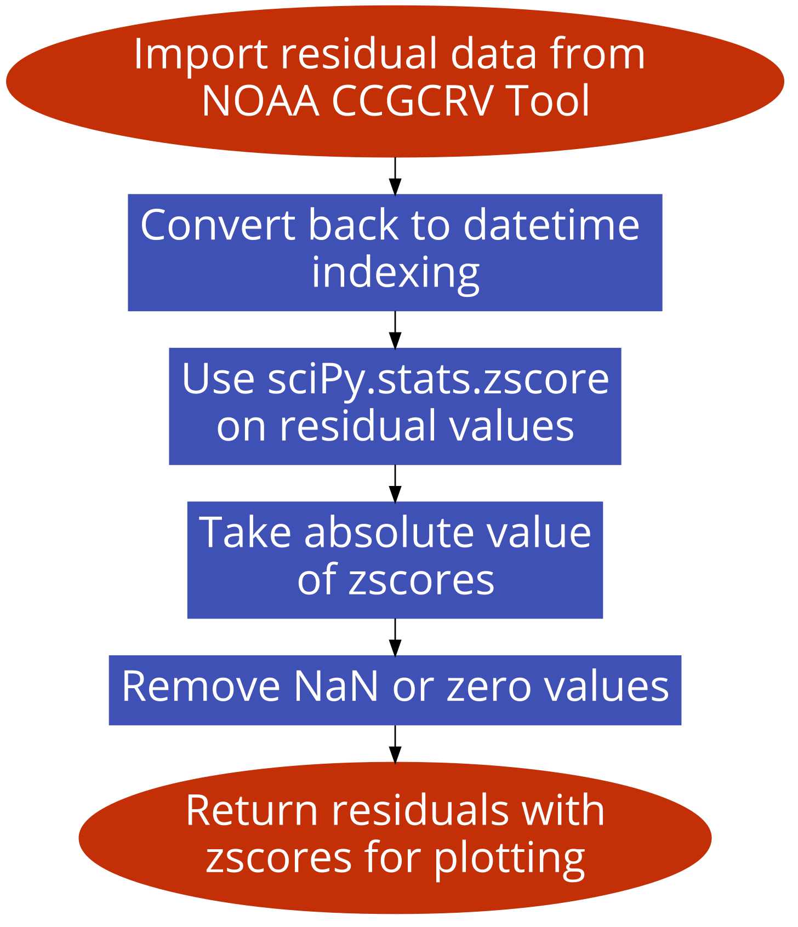
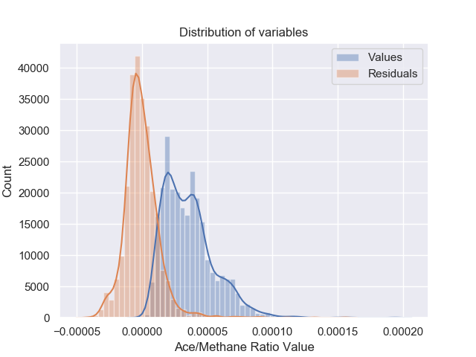
Z Score Creation

Slide 9
Creating HYSPLIT
Back Trajectories
Conditions:
72 Hours
Starting Altitude 50m
Each trajectory starts at ratio data point timestamp (every 8 hours)
Originates from longitude, latitude : (-38.4592, 72.5796), TAWO site
Trajectory generates a coordinate every hour, 72 points in each trajectory

Slide 10
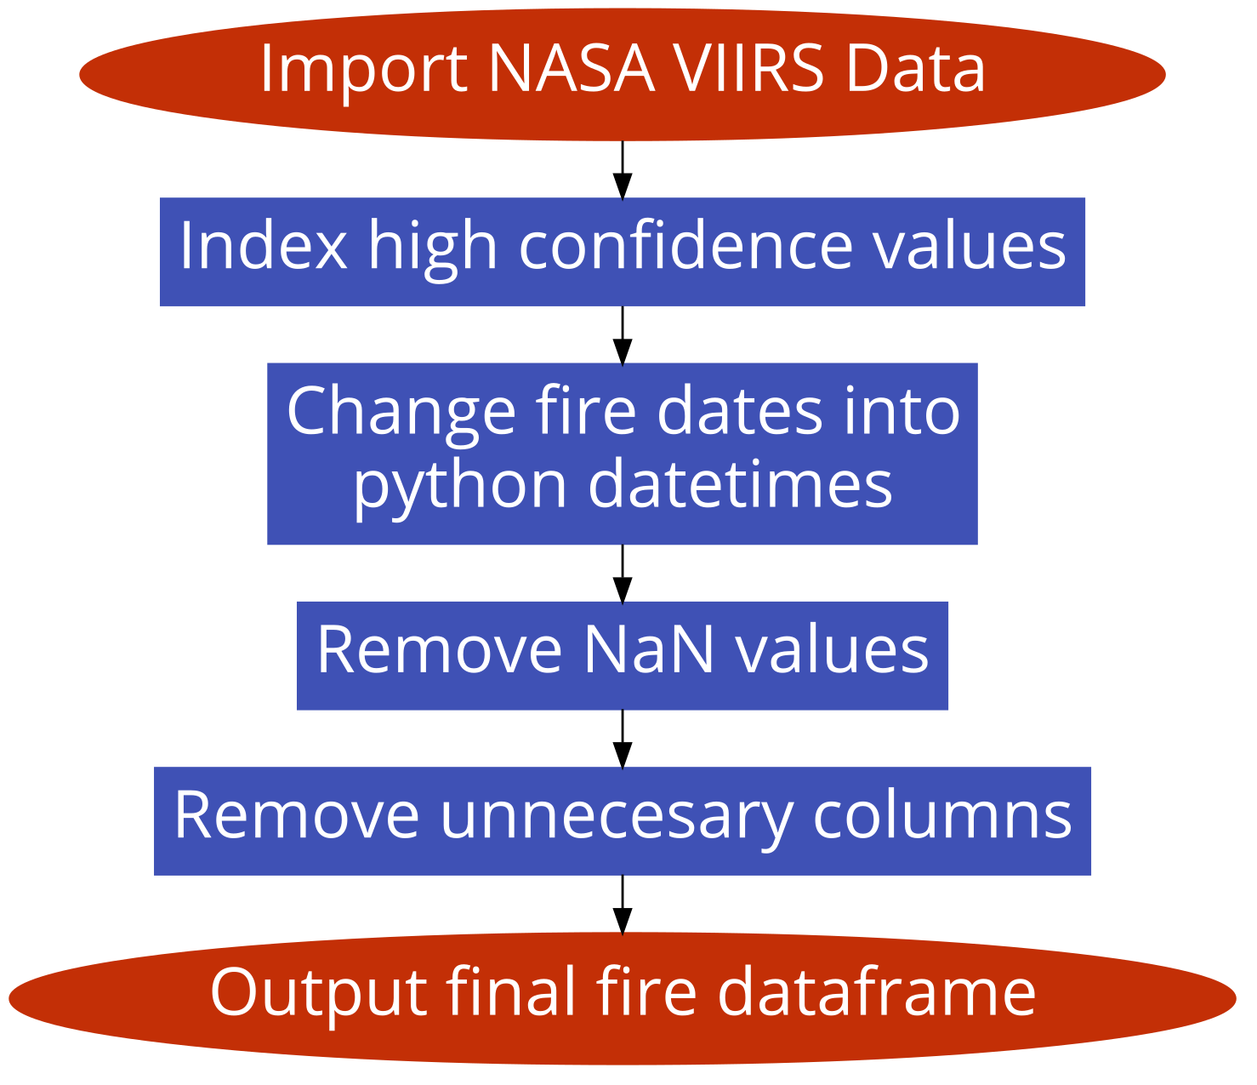
NASA VIIRS Fire Data
“Low confidence daytime fire pixels are typically associated with areas of sun glint and lower relative temperature anomaly (<15K).”
“Nominal confidence pixels are those free of potential sun glint contamination during the day and marked by strong (>15K) temperature anomaly”
Still 250k high confidence fires

Slide 11
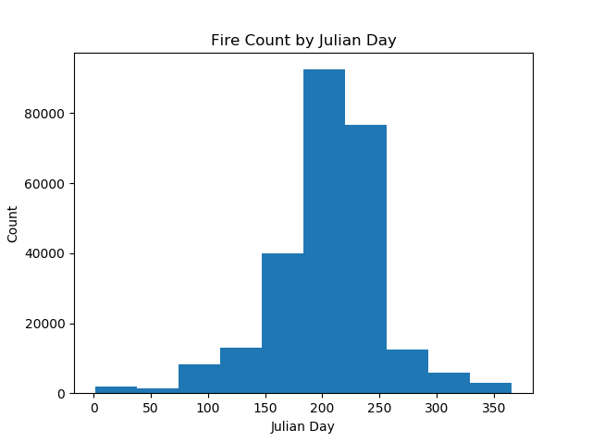
Fire Data Trimming
Majority of fires between Julian days 120 - 305. (May - November)
Trim values outside of this region to increase speed of creating back trajectories and matching fires.

Slide 12
Matching Trajectories to Fires
Conditions:
Coordinates of a fire are within one whole decimal degree of any point in a given trajectory
Timestamp of fire is within 24 hours of any timestamp on the trajectory.

Slide 13
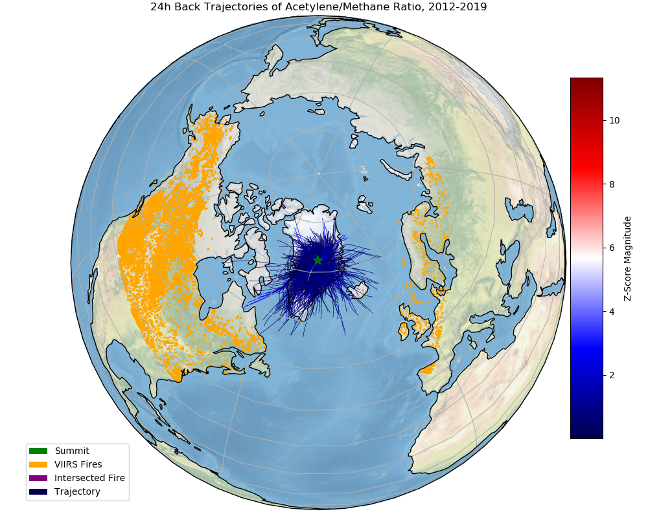
24 Hour Back
Trajectories

Slide 14
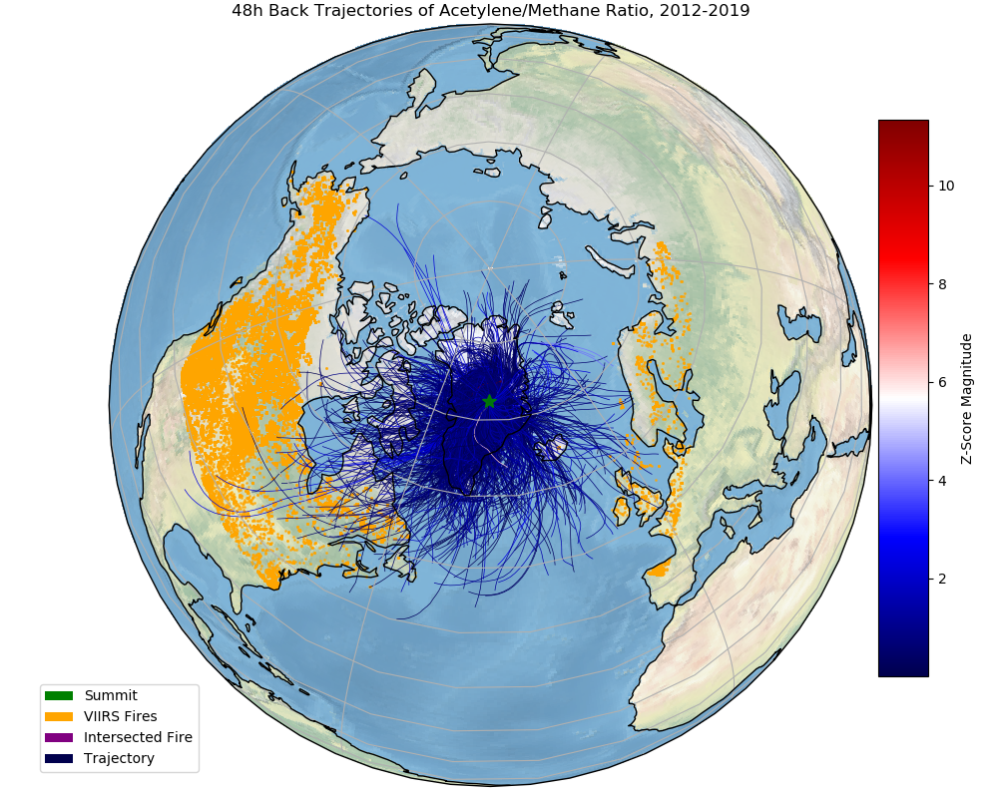
48 Hour Back
Trajectories

Slide 15
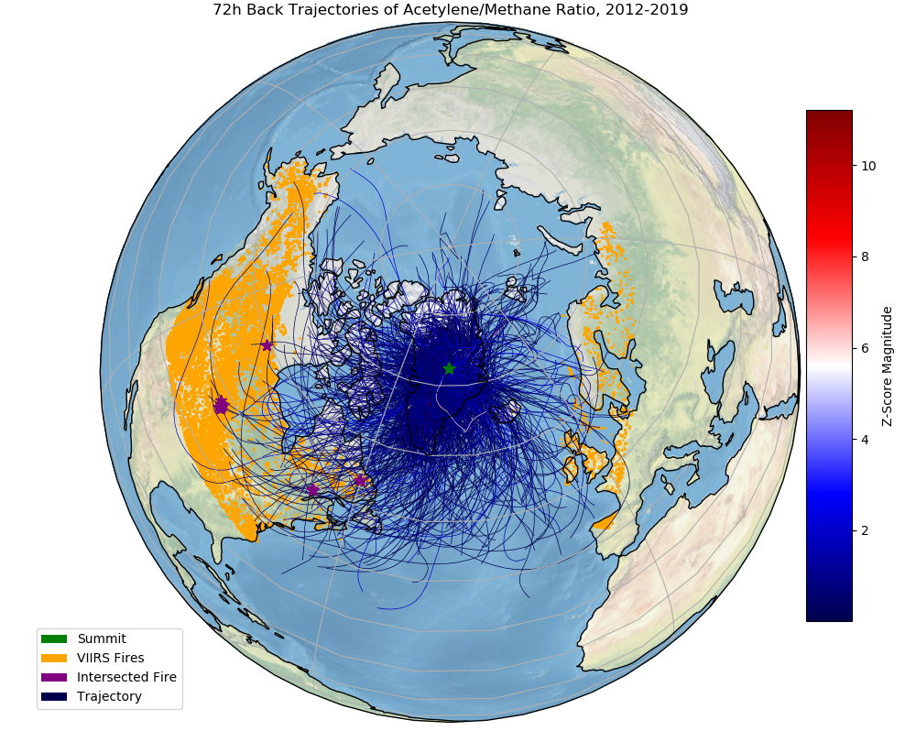
72 Hour Back
Trajectories

Slide 16
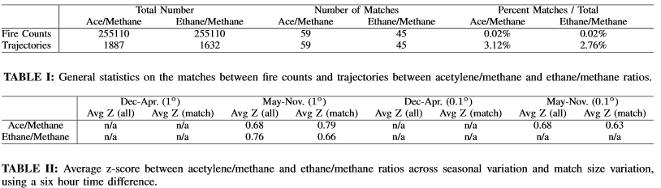
Reported Statistics
No correlation between z score and matches
Low number of matches

Slide 17
Conclusions
Low number of matches for both ratios
Z-scores have no correlation with matches
however...
High uncertainty in back trajectory method, doesn’t take dispersion of trajectories or of fires into account
Uncertain matching conditions, fires could last longer?
needs...
To use more advanced trajectory models → Flexpart
To do a full sensitivity analysis across many conditions

